Slide 1
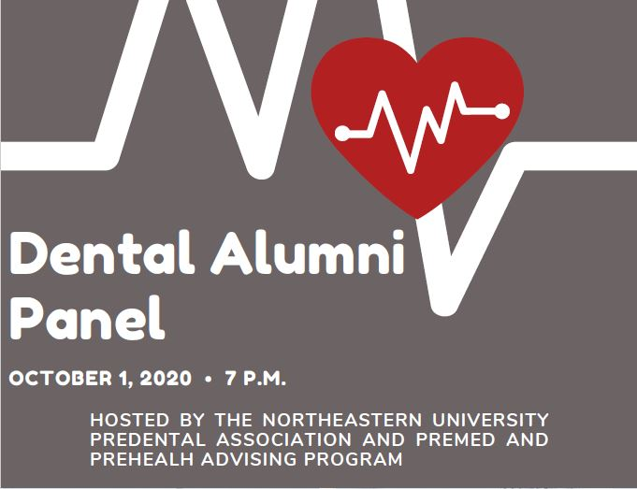
Notes:
Nearly all our well-qualified applicants are accepted the first time they apply.
Alumni report a high rate of satisfaction with the schools they attend.

Slide 2
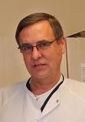
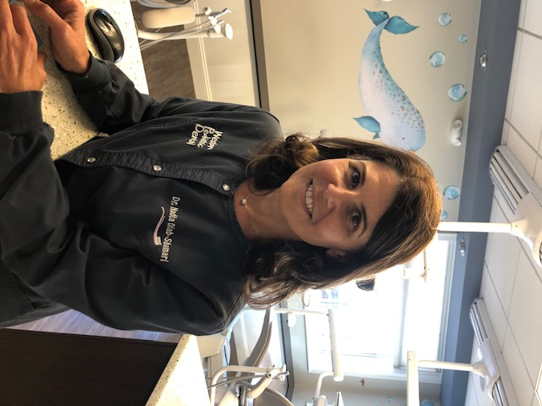
Introductions
Peter Alan Blanchard, BS, DDS, MBA first developed his fascination with the life sciences as an undergraduate in the BS program, biology, at Northeastern University. Despite late hours in the Mugar labs counting and classifying mutations in fruit flies, the complexity of nature’s machines convinced him to pursue a career in health care. Peter graduated the program, cum laude, in 1978 and immediately pursued a doctoral degree in Dentistry at Georgetown University. He immediately began practice as a Lieutenant in the US Public Health Service stationed at a community health facility in Boston. It was here that Dr. Blanchard fine- tuned the art of his profession and learned the importance of patient centric care. Recognizing the challenges of the current delivery system, Peter matriculated in Boston University’s Health Care Management MBA program. Combining rich clinical experience with a perspective of key business factors further inspired his work. Following this great experience Peter continued to practice in multi-specialty group practice settings throughout his career. He served as Chief of Dentistry at Harvard Community Health Plan Braintree Center and then as Clinical Director, President and Director of Evidence Based Care at the DentaQuest Oral Health Center in Westborough, Ma.
Dr. Blanchard has been privileged to collaborate with leaders in the field of Dental Research. He has co-authored a number of papers published in peer reviewed journals. The primary scope of his research interest lies in cardiology and caries management in the clinical setting. Evidence Based Dentistry holds the promise to bring the right care to right patient at the right time!
Dr. Nadia Diab-Shamari received her undergraduate degree in biology from Northeastern University. From there, she earned her dental degree at Tufts University School of Dental Medicine. Dr. Diab also holds a Certificate of Pediatric Dentistry from the Medical College of Virginia, she is a board certified Pediatric Dentist. She has extensively volunteered locally and internationally providing free dental care to children. She's currently involved with Northeastern University through their pre-dental program as a mentor and a coop employer.
Notes:
Student panel introduction
Name, where you are from, your major, expected graduation year, and a brief synopsis of your experiential learning opportunities you’ve done and organizations you are involved in on campus
Starter Questions:
Why did you choose Northeastern?
How did you choose your major?
How have your co-op and other extracurricular experiences impacted your desire to pursue medicine?
What resources or opportunities at Northeastern did you find most helpful in your medical school preparation?
What unique experiences have you had at Northeastern that you can't get at other schools?
What is the most challenging and the most exciting aspects of being a Northeastern pre-health student?
What piece of advice would you give to current high school seniors who are going through the college application process?

Slide 3
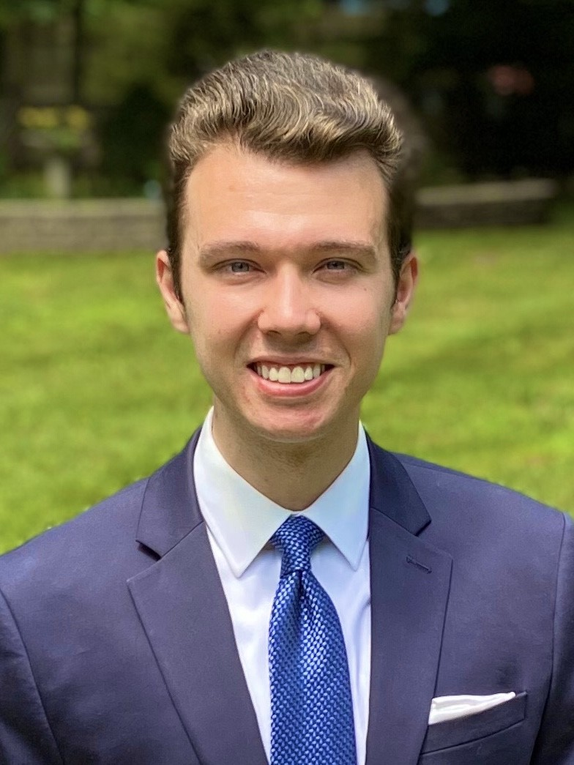
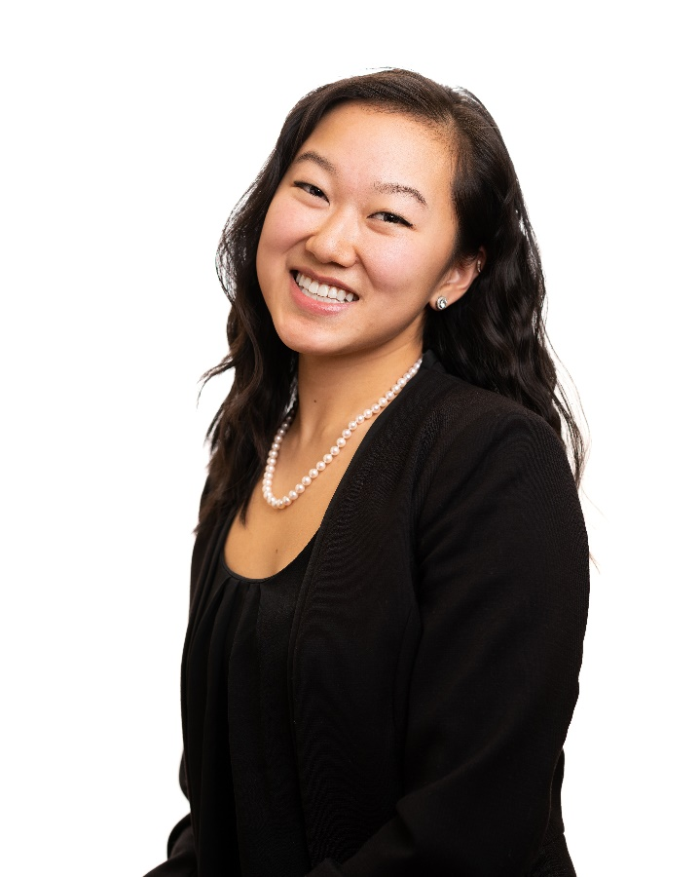
Introductions
Vance Consalvo, D.M.D. is a graduate of the Northeastern University Class of 2015 where he earned a B.S. in Biology from the College of Science. During his time at Northeastern he was president of the Pre-Dental Association and co-oped at the Tufts University School of Dental Medicine's Craniofacial Pain Center before enrolling in the dental school in summer of 2015. After graduating from TUSDM in 2019 Vance began a yearlong clinical residency in Nashville, TN through NYU Langone's Advanced Education in General Dentistry program. This summer he returned to his hometown of Washingtonville, NY where he accepted an associateship at Masci & Hale: Advanced Aesthetic Restorative Dentistry in nearby Montgomery, NY.
Diana Kim is a graduate of the Northeastern University Class of 2016 where she earned a B.S. in Biology from the College of Science and a Minor in Health Science from the Bouve College of Health Sciences. During her time at Northeastern, she was the founding president of Global Medical Brigades on campus, past president of Pre-Dental Association, and an artistic director of Kinematix Dance Troupe. She completed a co-op at Bicon Dental Implants as well as Repligen Corporation. Currently a third year dental student at Stony Brook School of Dental Medicine, Diana is very involved with American Student Dental Association, Academy of General Dentistry, SDM Alumni Board, and Hispanic Student Dental Association. She loves mentoring and advising pre-dental students and is always open to answering questions about her journey and dental school experience.
Notes:
Student panel introduction
Name, where you are from, your major, expected graduation year, and a brief synopsis of your experiential learning opportunities you’ve done and organizations you are involved in on campus
Starter Questions:
Why did you choose Northeastern?
How did you choose your major?
How have your co-op and other extracurricular experiences impacted your desire to pursue medicine?
What resources or opportunities at Northeastern did you find most helpful in your medical school preparation?
What unique experiences have you had at Northeastern that you can't get at other schools?
What is the most challenging and the most exciting aspects of being a Northeastern pre-health student?
What piece of advice would you give to current high school seniors who are going through the college application process?

Slide 4
Moderated Panel Discussion
Dr. Nadia Diab –Shamari,
Peter Alan Blanchard, BS, DDS, MBA
Vance Consalvo, D.M.D.
Diana Kim
Notes:
Student panel introduction
Name, where you are from, your major, expected graduation year, and a brief synopsis of your experiential learning opportunities you’ve done and organizations you are involved in on campus
Starter Questions:
Why did you choose Northeastern?
How did you choose your major?
How have your co-op and other extracurricular experiences impacted your desire to pursue medicine?
What resources or opportunities at Northeastern did you find most helpful in your medical school preparation?
What unique experiences have you had at Northeastern that you can't get at other schools?
What is the most challenging and the most exciting aspects of being a Northeastern pre-health student?
What piece of advice would you give to current high school seniors who are going through the college application process?

Slide 6
Connect with our Panelists
Peter Alan Blanchard, BS, DDS, MBA
peterblanc@aol.com
Dr. Nadia Diab-Shamari
ndiab6@gmail.com
Vance Consalvo, D.M.D.
vconsalvo@hvc.rr.com
Diana Kim
diana.kim@stonybrookmedicine.edu
IG: @DianaKim_Future.DDS
Connect with the Pre-Dental Association
@NEUPreDental
Connect with the PreMed and PreHealth Advising Program
@NUPreHealth

